Slide 1
Biology FA 1
`

Slide 2
Facts about imbibition,
Diffusion, Plasmolysis
and osmosis.

Slide 3
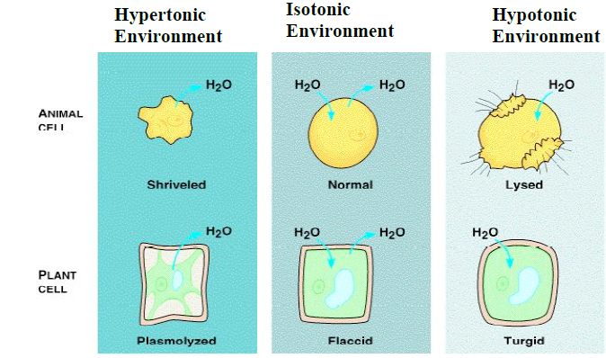
When two solutions are compared to each other, the solution with a higher solute concentration is referred to as hypertonic
and the solution with a lower solute concentration is referred to as hypotonic.
If the two solutions have equal concentration, they are said to be isotonic.

Slide 4
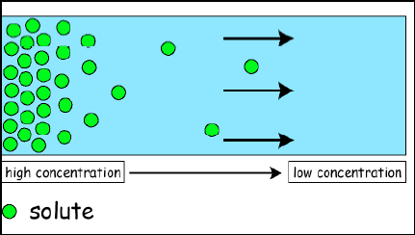
The simplest form of movement is diffusion, in which solutes move from an area of high concentration to an area of low concentration; diffusion is directly related to molecular kinetic energy. Diffusion does not require energy input. The movement of a solute from an area of low concentration to an area of high concentration requires energy input in the form of ATP and protein carriers called pumps.

Slide 5
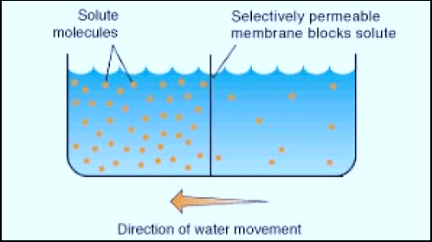
One property of a living system is active transport. This process uses energy from ATP to move substances through the cell membrane. Active transport moves substances against a concentration gradient, from a region of low concentration to a region of high concentration.

Slide 6
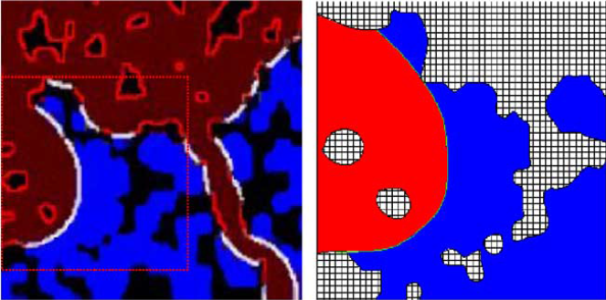
If one were to open a bottle of hydrogen sulfide (H2S has the odor of rotten eggs) in one corner of a room, it would not be long before someone in the opposite corner would also recognize the smell of rotten eggs. The bottle contains a higher concentration of H2S molecules than the room does and, therefore, the H2S gas diffuses from the area of higher concentration to the area of lower concentration. Eventually a dynamic equilibrium will be reached; the concentration of H2S will be approximately equal throughout the room and no net movement of H2S will occur from one area to the other.

Slide 7
Vinay Sachdeva
••••••••••••••••••••••••••••••••••
IX-H
••••••••••••••••••••••••••••••••••
10563/26
••••••••••••••••••••••••••••••••••

